Slide 1
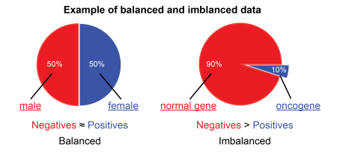
Imbalanced-learn
“imblearn” is a python toolbox to tackle the problem of imbalanced datasets in machine learning.

Slide 2
4 types of methods
Under sampling
Over sampling
Combination of over and under sampling
Ensemble learning

Slide 3
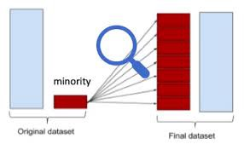
Over sampling(Up sampling)
This technique is used to modify the unequal data classes to create balanced datasets.
When the quantity of data is insufficient, the oversampling method tries to balance by incrementing the size of rare samples.
Over-sampling increases the number of minority class members in the training set.
ADVANTAGES:
No loss of information.
DISADVANTAGES:
Overfitting.

Slide 4
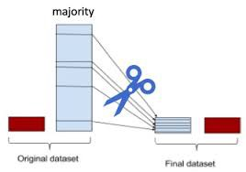
Under sampling(Down Sampling)
Under-sampling, on contrary to over-sampling, aims to reduce the number of majority samples to balance the class distribution.
Since it is removing observations from the original data set, it might discard useful information.
ADVANTAGES:
Run-time can be improved by decreasing the amount of training dataset.
DISADVANTAGES:
Losing some critical information

Slide 5
Imbalanced-learn
Imbalanced-learn is a python package offering a number of re-sampling techniques commonly used in datasets showing strong between-class imbalance.
It is compatible with scikit-learn and is part of scikit-learn-contrib projects.

Slide 6
Oversampling methods
Random Over Samplerimblearn.over_sampling.RandomOverSampler
Adaptive Synthetic (ADASYN) imblearn.over_sampling.ADASYN
Borderline SMOTE imblearn.over_sampling.BorderlineSMOTE
Kmeans SMOTE imblearn.over_sampling.KMeansSMOTE
Synthetic Minority Oversampling Technique (SMOTE) imblearn.over_sampling.SMOTE

Slide 7
The most naive strategy is to generate new samples by randomly sampling with replacement the current available samples.
Apart from the random sampling with replacement, there are two popular methods to over-sample minority classes:
Synthetic Minority Oversampling Technique (SMOTE) [CBHK2002]
Adaptive Synthetic (ADASYN) [HBGL2008] sampling method.
We can use it by following:
from imblearn.over_sampling import RandomOverSampler, SMOTE, ADASYN
While the Random Over Sampler is over-sampling by duplicating some of the original samples of the minority class, SMOTE and ADASYN generate new samples in by interpolation.
However, the samples used to interpolate/generate new synthetic samples differ.
In fact, ADASYN focuses on generating samples next to the original samples which are wrongly classified using a k-Nearest Neighbors classifier while the basic implementation of SMOTE will not make any distinction between easy and hard samples to be classified using the nearest neighbors rule.
Therefore, the decision function found during training will be different among the algorithms.

Slide 8
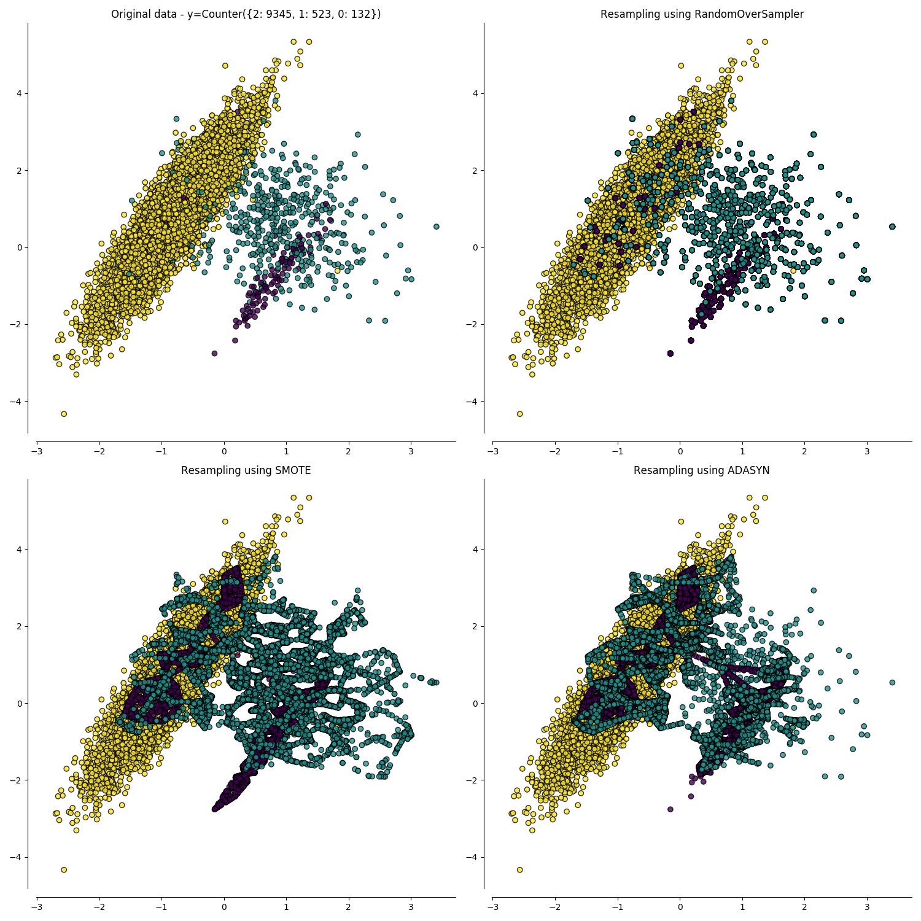

Slide 9
Some variants of SMOTE
BorderlineSMOTE
SVMSMOTE imblearn.over_sampling.SVMSMOTE
KMeansSMOTE
SMOTENC (for categorical data) imblearn.over_sampling.SMOTENC
from imblearn.over_sampling import BorderlineSMOTE, SMOTENC, SVMSMOTE, KMeansSMOTE

Slide 10
The regular SMOTE algorithm does not impose any rule and will randomly pick-up all possible xi available.
The borderline SMOTE with the parameters- kind='borderline-1' and kind='borderline-2' — will classify each sample xi to be (i) noise (i.e. all nearest-neighbors are from a different class than the one of xi), (ii) in danger (i.e. at least half of the nearest neighbors are from the same class than xi, or (iii) safe (i.e. all nearest neighbors are from the same class than xi).
Borderline-1 and Borderline-2 SMOTE will use the samples in danger to generate new samples.
SVM SMOTE uses an SVM classifier to find support vectors and generate samples considering them. Note that the C parameter of the SVM classifier allows to select more or less support vectors.
For both borderline and SVM SMOTE, a neighborhood is defined using the parameter m_neighbors to decide if a sample is in danger, safe, or noise.

Slide 11
KMeans SMOTE uses a KMeans clustering method before to apply SMOTE. The clustering will group samples together and generate new samples depending of the cluster density.
ADASYN works similarly to the regular SMOTE. However, the number of samples generated for each xi is proportional to the number of samples which are not from the same class than xi in a given neighborhood. Therefore, more samples will be generated in the area that the nearest neighbor rule is not respected. The parameter m_neighbors is equivalent to k_neighbors in SMOTE.

Slide 12
Under Sampling methods
Prototype generation
Prototype Selection
Controlled Under-sampling
Cleaning Under-sampling

Slide 13
REFERENCES
https://www.analyticsindiamag.com/5-important-techniques-to-process-imbalanced-data-in-machine-learning/
· https://en.wikipedia.org/wiki/Oversampling_and_undersampling_in_data_analysis
https://imbalanced-learn.readthedocs.io/en/stable/introduction.html
https://imbalanced-learn.readthedocs.io/en/stable/over_sampling.html
https://imbalanced-learn.readthedocs.io/en/stable/under_sampling.html
https://imbalanced-learn.readthedocs.io/en/stable/ensemble.html

